Slide 2
Towing and recovery incentive program t.r.i.p.
Awareness Training for TRIP Stakeholders
Narrated by Scott Kapton, Parsons. TRIP Project Manager
February 2023
Notes:
Welcome to the VDOT Towing and Recovery Incentive Program awareness training

Slide 3
Introduction

Slide 4
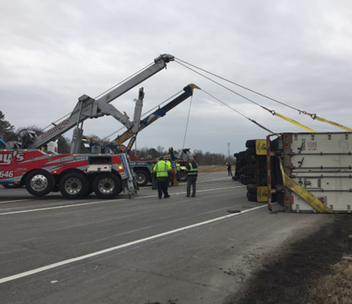
What is T.R.I.P?
TRIP is a quick clearance incentive program to pay heavy-duty recovery companies a monetary bonus for clearing Commercial Vehicle Crashes within 90 mins.
TRIP’s key objective is to STANDARDIZE the towing response and facilitate the safe and quick clearance of commercial vehicle crashes on the Interstate system

Slide 5
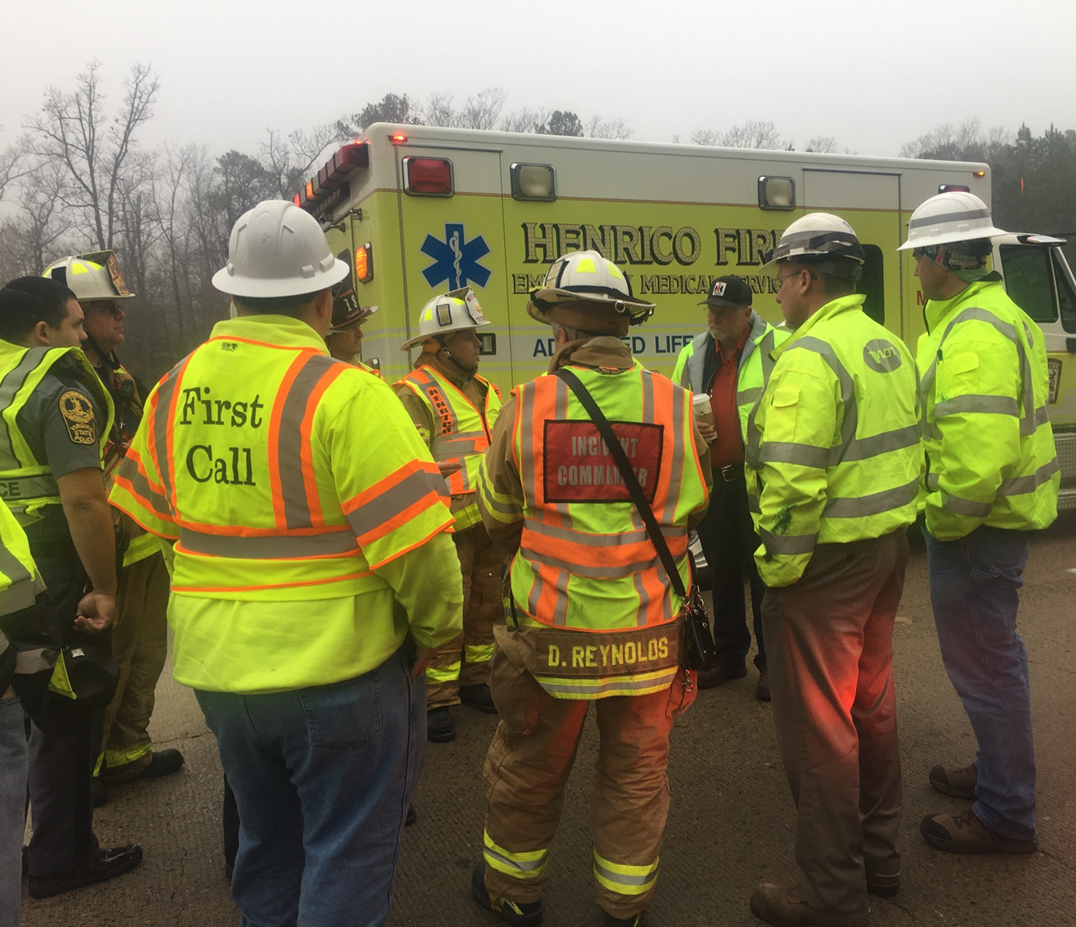
Program Benefits
TRIP benefits emergency responders by facilitating the safe, quick clearance of large commercial vehicle incidents, resulting in a reduction of responder exposure
The benefits for the traveling motorists will be interstate reliability, increased safety, saved time, saved costs from reduced congestion and most notably, a potential reduction in secondary incidents.
Towing and recovery companies will benefit on two fronts:
Increased safety resulting from proper training and partnering with other T.I.M. Stakeholders
Monetary incentives given for overall performance, proper equipment and quick clearance of travel lanes

Slide 6
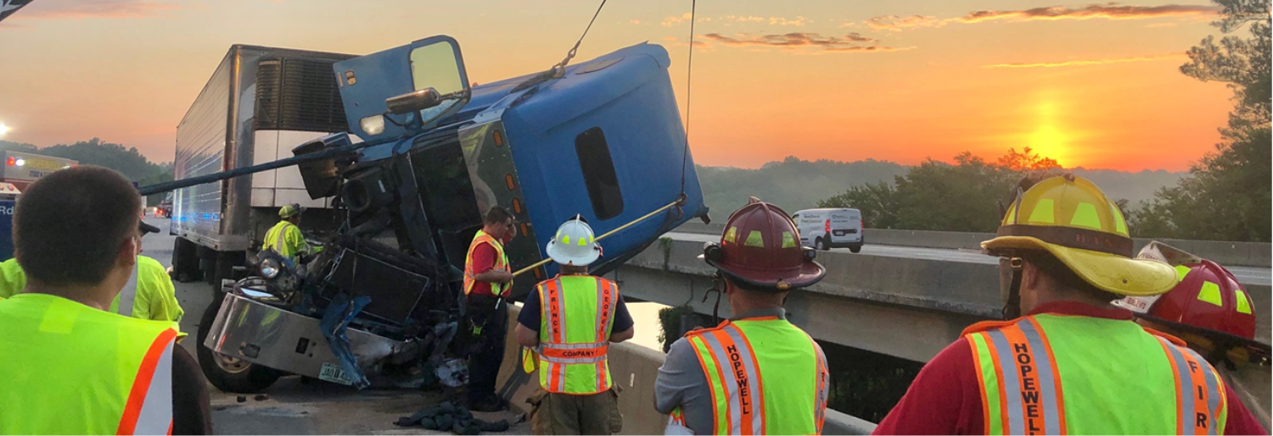
Safe, Quick Clearance
Is a Primary Focus of this program
Safety of responders is #1 priority
Reduce the amount of time on major crash scenes
Move it? Or work it?
Drag to a safer area if practical
Think outside of the box
May require specialized training and/or
discussion to increase awareness
Will require partnering with all responders to
facilitate
Safety of the motoring public
Keep lanes open whenever possible
Facilitate traffic flow and minimize queue
Reduce the likelihood of secondary crashes
Primary Focus of this program

Slide 7
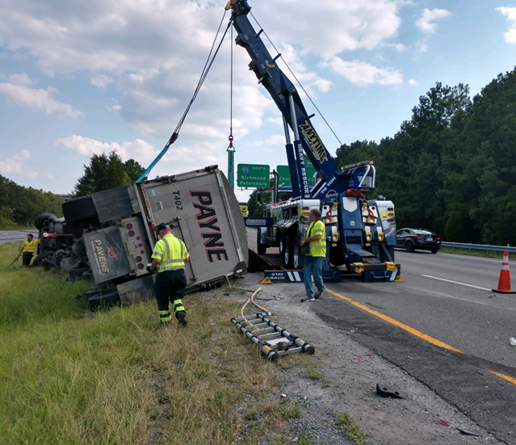
Program Overview
TRIP will be activated for all lane blocking or lane impacting commercial vehicle crashes by VDOT, VDOT TOC, Virginia State Police or Safety Service Patrol Operators
TRIP will also recover ALL other vehicles involved in the crash, eliminating multiple towing company response
Timekeepers: VDOT Traffic
Operations Center through
State Police or Safety Service
Patrol

Slide 8
TRIP Requirements- Compliance
Response Times:
45-60 mins. (peak hrs.) for on-scene wrecker crew
60-75 mins. (off-peak hrs.) for on-scene wrecker crew
Required PPE
Lane clearance within 90 minutes
Finish recovery from safer area if practical
Must participate in the Incident Command
process

Slide 9
Personnel and Equipment
30-ton and one 50-ton recovery wrecker (or 35
ton Rotator) with two TRIP qualified operators
Support truck including a full set of tools, traffic
control & fluid spill mitigation capability with one
TRIP qualified supervisor
A 3-man team response to every TRIP crash
Other specialized heavy equipment (low-boys,
skid-steer, sand spreaders, etc.)
24/7 equipment availability

Slide 10
Training Requirements
Operators and Supervisors with full
certifications:
Advanced heavy recovery and highway
clearance TRIP Level 1 and Level 2 training
provided by WreckMaster instructors
TRIP Level 1- Operators
TRIP Level 2- Supervisor
Hazardous Material awareness
OR: Hazwoper 24 or 48 hr class
SHRP2 Responder Training
NIMS 100 & 700
Virginia Work Area Protection Manual

Slide 11
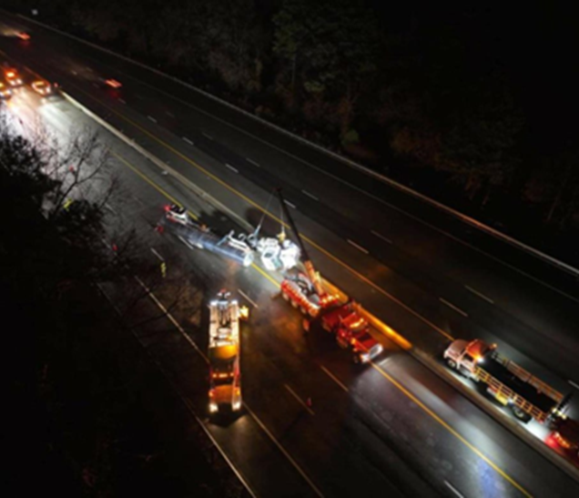
Recovery Zones
37 TRIP towing companies currently participating
Over 600 miles of coverage/ designed for response
All assigned to either a singular or two-way
rotation recovery zone
Rotations: 1 week on 1 week off.
24/7/365 coverage
No owner request for allowed in TRIP
TRIP towers will handle all CMV involved
casualties as well as all personal vehicles that
may be involved

Slide 12
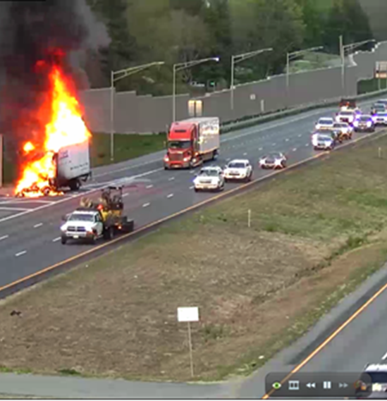
TRIP Performance Measures
The key to validating the improvements and benefits
Reduction in Response Times
Improvements in Roadway Clearance Times
Reduction in Travel-Lane Blockage
Reduction in Overall Incident Duration
Dollar Saving from Reduced Congestion

Slide 13
T.I.M. Timeline Primary Focus: T2-T6

Slide 14
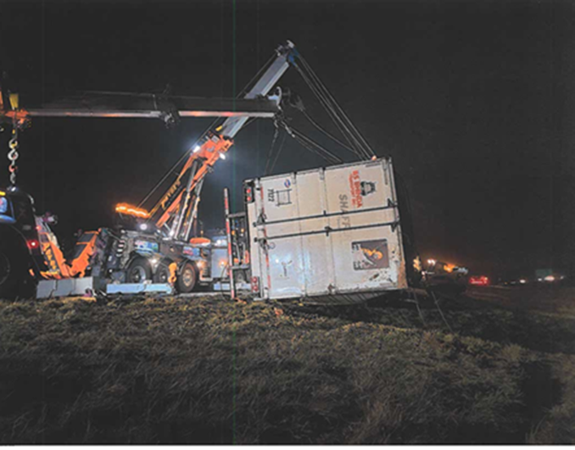
T.R.I.P. Activation Criteria
Tractor Semi-Trailer Combinations
(DOT Class 8)
Trucks over 26,000 lbs. and ‘Bobtail’ Tractors (DOT Class 7 or 8)
Moving trucks/ delivery trucks/ box trucks
Large Motor Homes and Motor Coaches (DOT Class 5 and 6)
Busses (16 passenger or more, DOT Class 6, 7 & 8)
Trucks towing loaded equipment trailers, campers, car haulers or cargo trailers
Any Aircraft

Slide 15
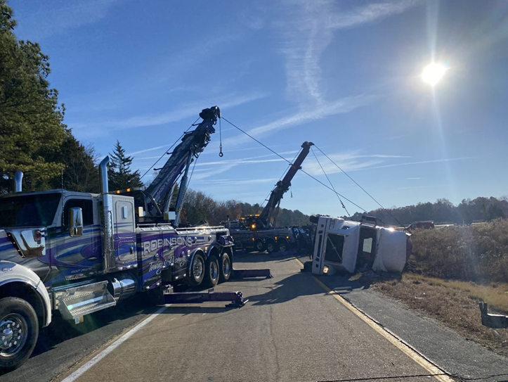
Rollover Commercial Vehicle

Slide 16
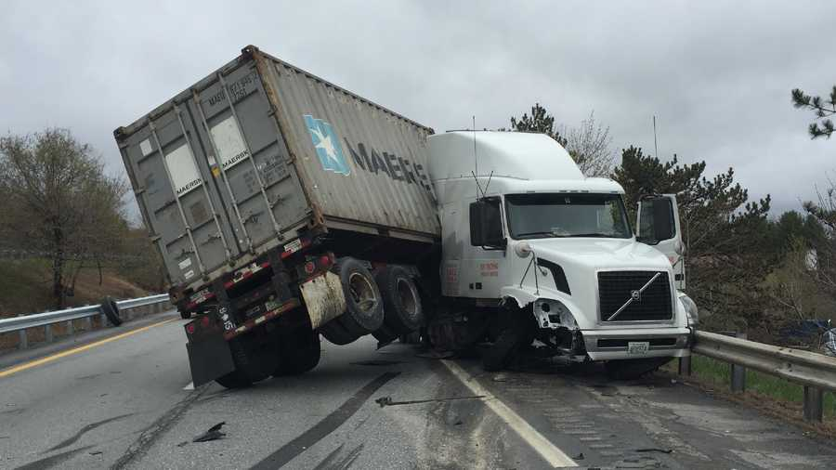
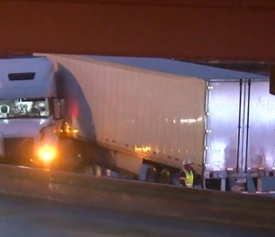
Jackknife

Slide 17
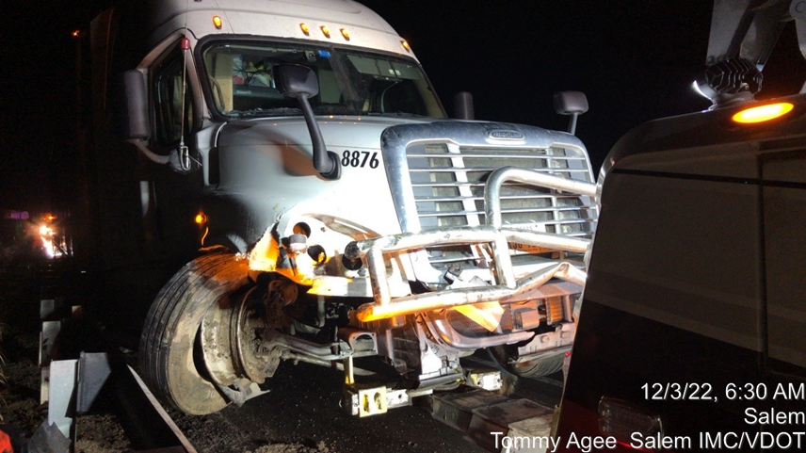
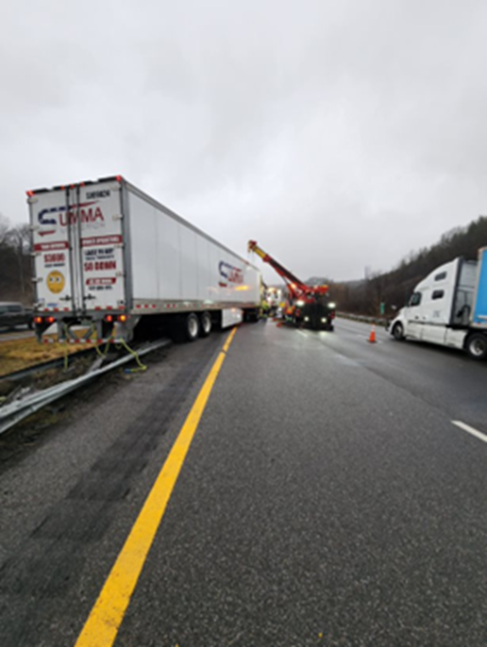
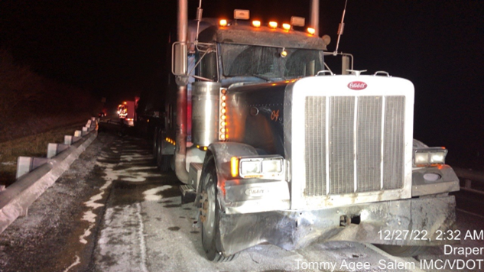
Upright With Heavy Damage

Slide 18
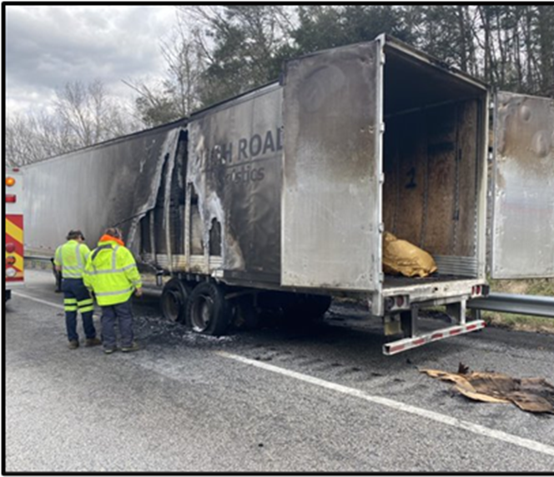
Fire: Visible Flame and/or Heavy Black Smoke

Slide 19
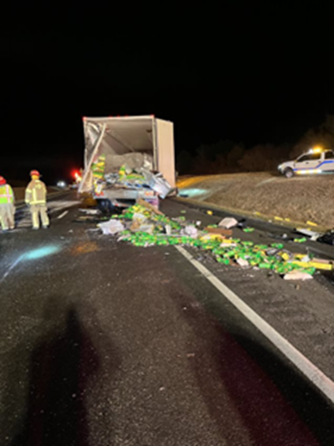
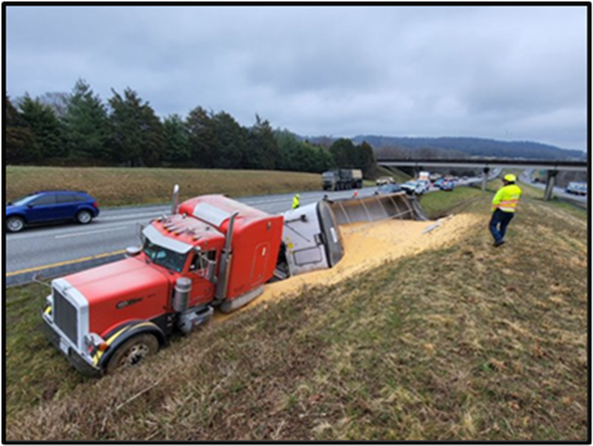
Lost or Shifted Loads

Slide 20
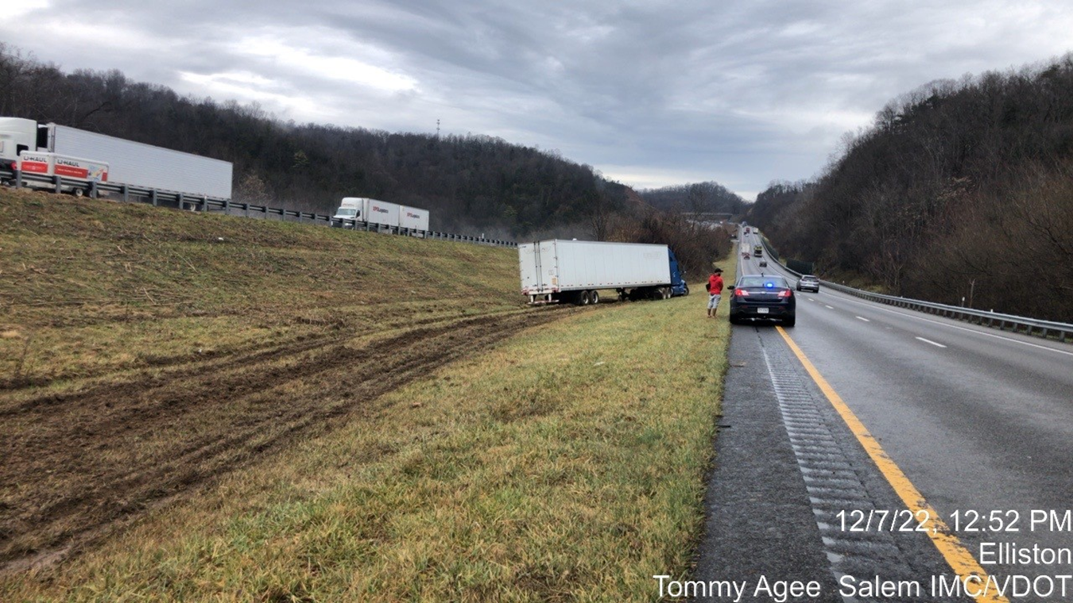
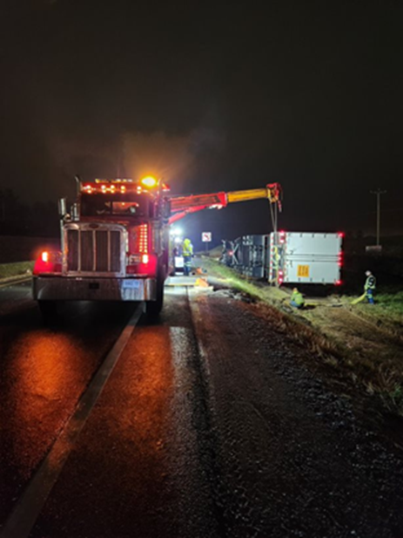
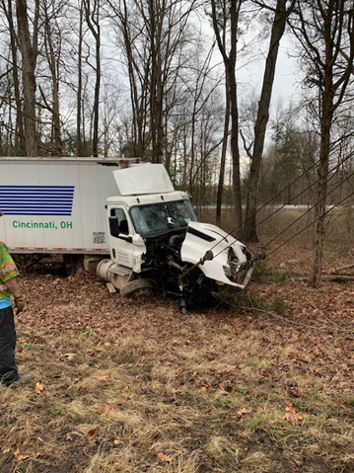
Special Circumstance/ CMV crash off of the roadway

Slide 21
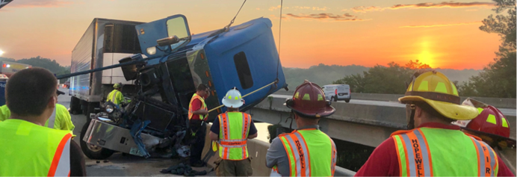
Serious Injury or Possible Fatality

Slide 22
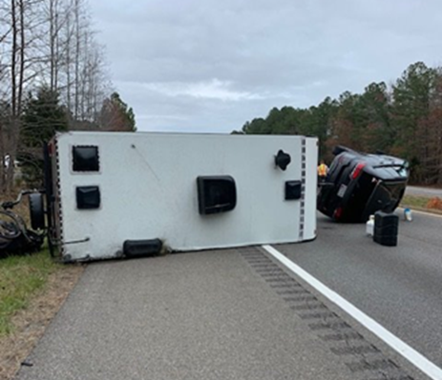
Other Potential TRIP Activations/ Judgement Call

Slide 23
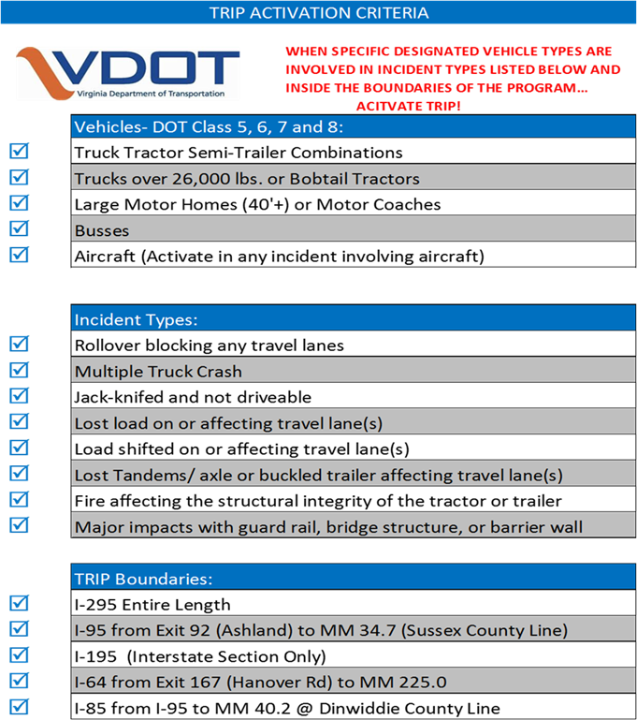
TRIP Activation Chart/ example

Slide 24
TRIP Determination/ Activation
First TRIP authorized responder:
Shall notify either Virginia State Police Dispatch or the VDOT Traffic Operations Center that the crash qualifies for TRIP activation
Can activate TRIP with visual confirmation while en-route
Provide as much specific detail to the Traffic Operations Center to ensure proper TRIP response
Coordinate with additional responders to prepare the crash scene
Applies to lane blockage on mainline lanes and ramp lanes or any Response that may impact lanes

Slide 25
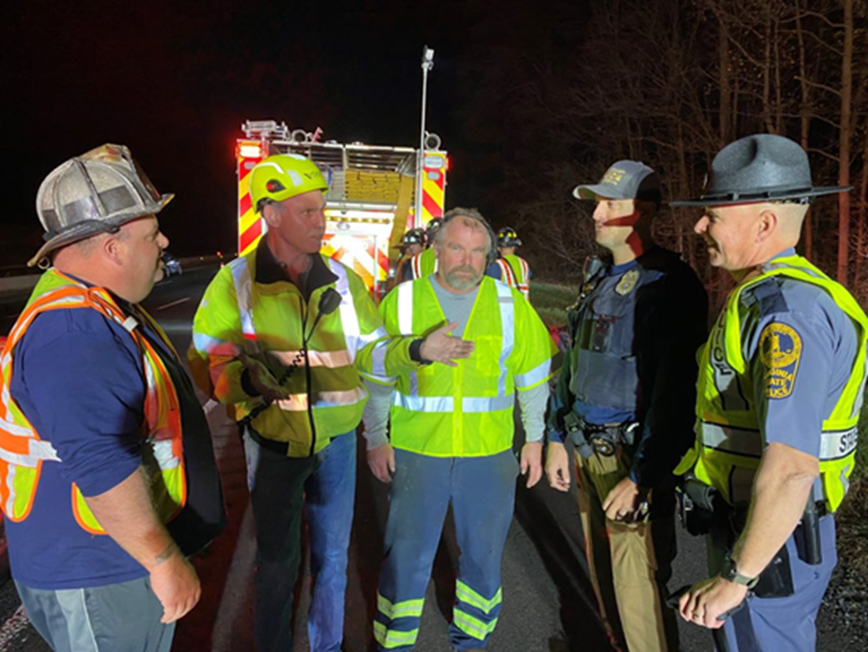
TRIP Notice to Proceed (NTP)
Given by on scene command
Once all other non towing issues have been resolved
Once a clearance and recovery plan has been discussed
Begins the 90-minute clearance timeline
Time must be communicated to the VDOT TOC
and logged on scene
90-minute clock for TRIP stops if on scene
command stops the recovery process for any
reason: e.g.
Safety reasons
Further investigation
90-minute clock restarts when the Incident Commander gives the Notice to Proceed to continue the recovery process

Slide 26
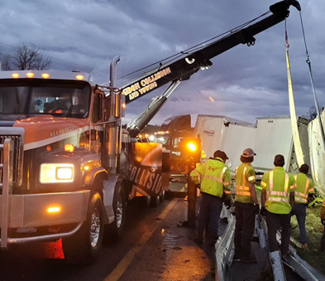
TRIP- 90 Minute Lane Clearance
Applies to clearance of the live travel lanes
Recovery and cleanup effort may continue
beyond 90 minutes from the shoulder or other
non-driving lane area deemed appropriate by IC
Lane clearance time must be communicated to
the TOC for time stamping.
Critical to the recordkeeping necessary to pay
out incentives for meeting the goals of the TRIP
response and clearance of the roadway
Must be a collaborative effort between all crash
scene stakeholders.

Slide 27
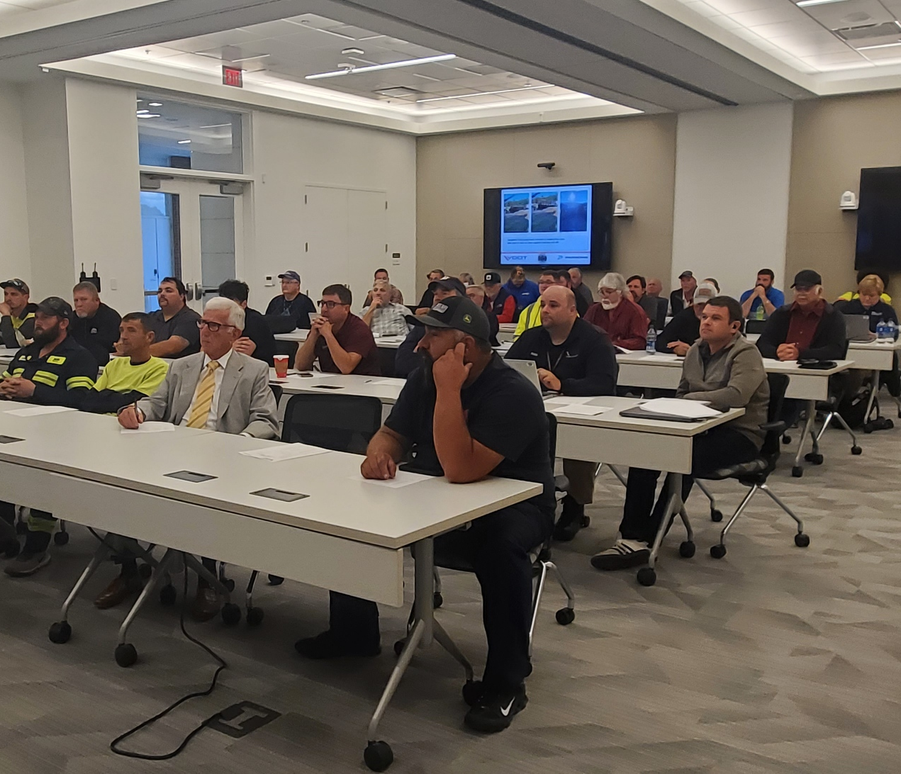
After Action Reviews/ Relationship Building
Each month, an After-Action Review
meetings (A.A.R.) are held at 4 locations
around Virginia to review the previous
months TRIP crashes
All towing companies are required to attend
each month. All TRIP stakeholders are also
invited to attend.
On scene TRIP manager (VDOT, SSP or
VSP) presents a brief overview of each
crash outlining the details and cite if TRIP
performance measures were met and
determine incentive payment
The TRIP towing company representative will
also provide any issues or challenges

Slide 28
Strong Relationships

Slide 29
Questions?
Scott Kapton
Parsons
TRIP Project Manager
804-840-7414
Scott.kapton@parsons.com
THANK YOU!
STAY SAFE

